Slide 1
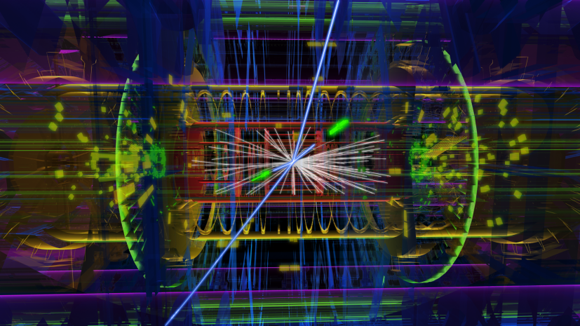


a glimpse of physics at the Terascale
Zinonas Zinonos

Slide 2
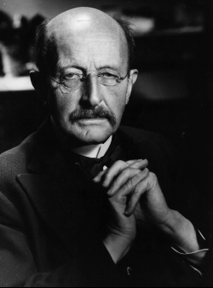
“Cognition precedes application”
Max Planck, 1858-1947

Slide 3
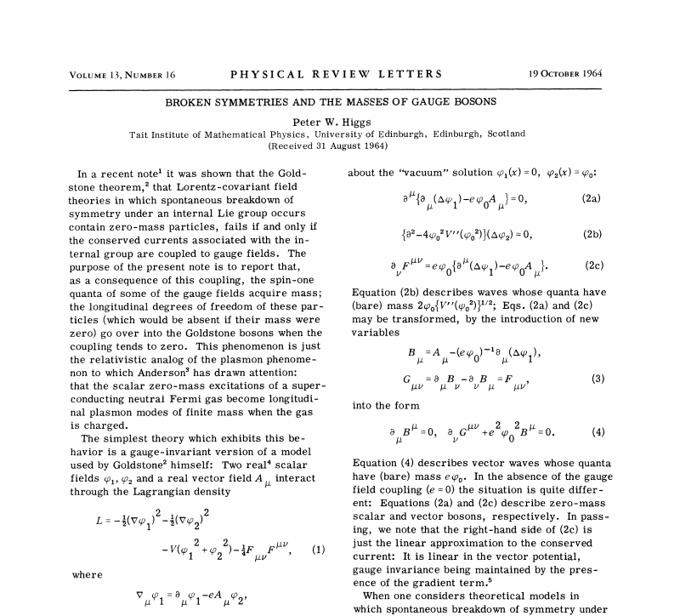

Slide 4
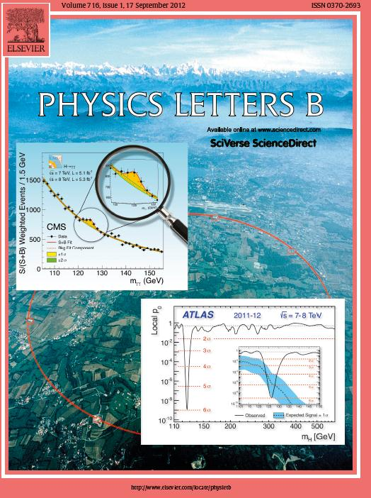
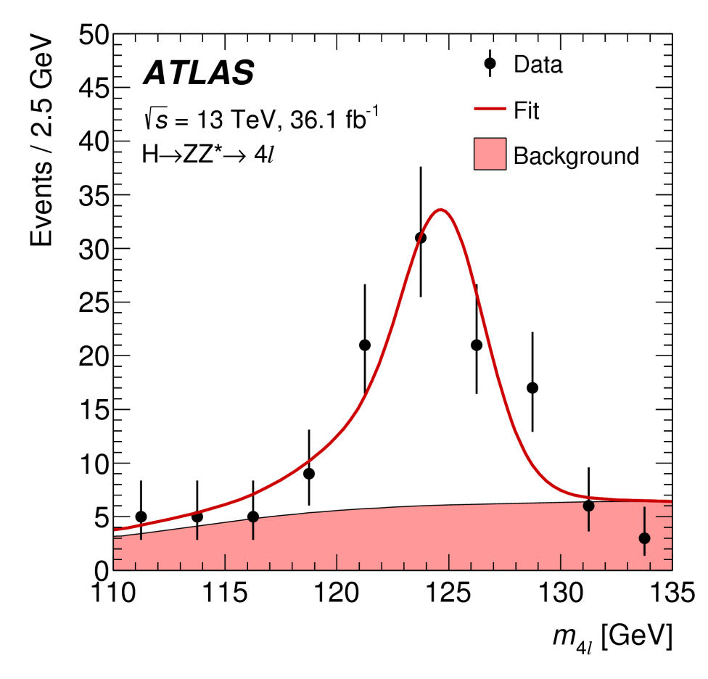
2018
2012

Slide 5
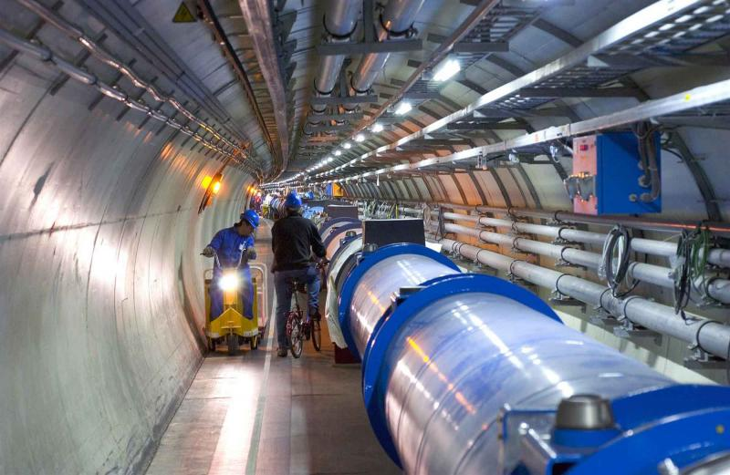
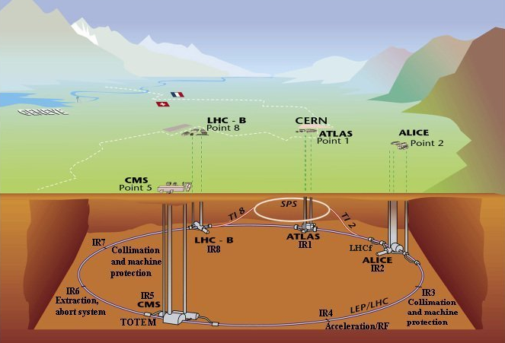
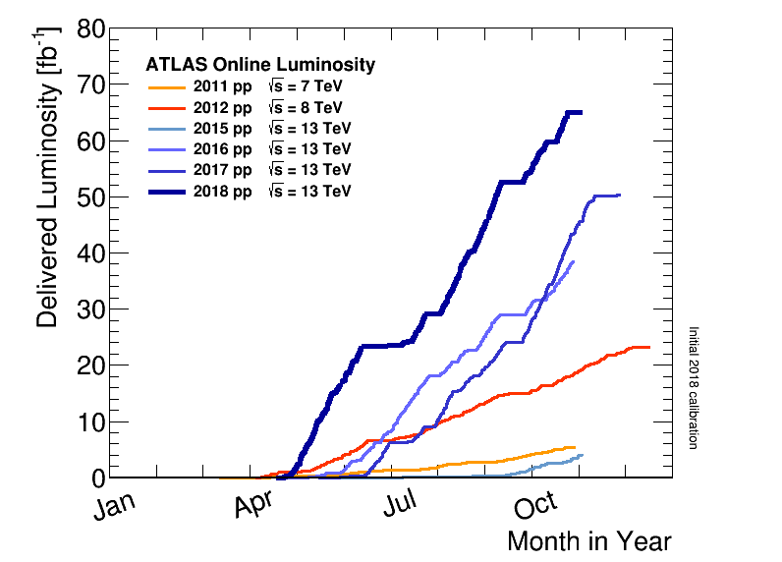
“Application verifies cognition”
Mankind’s most powerful tool to probe physics at the TeV scale, 2008-2040

Slide 6
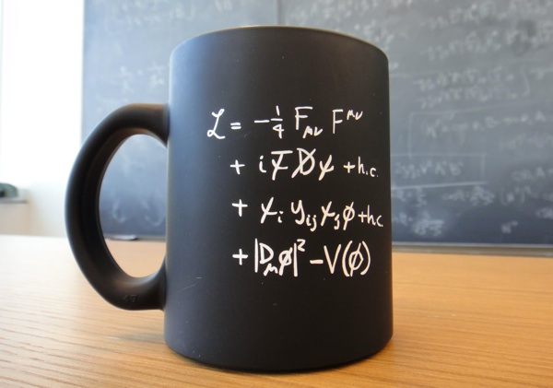

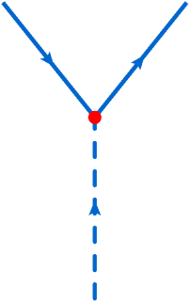
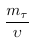
τ⁺
τ⁻
H

Slide 7
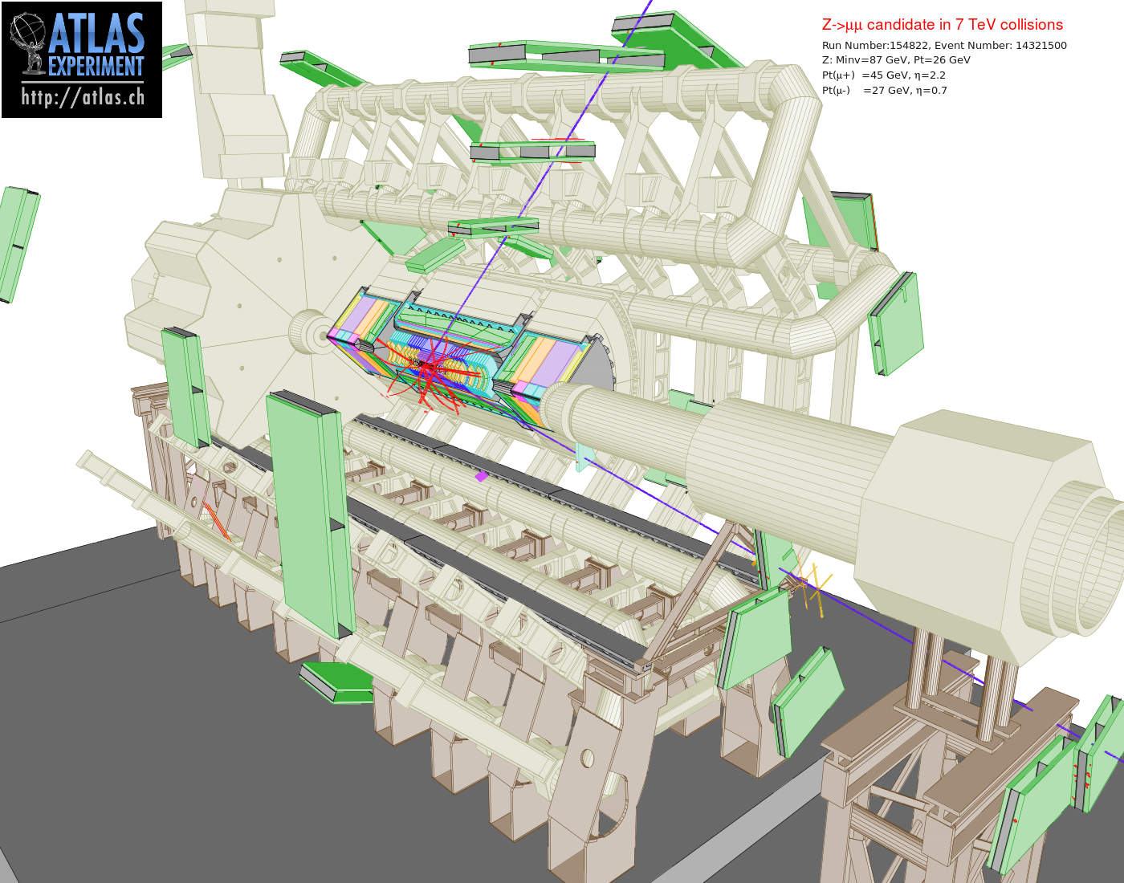
multi-purpose
giant
symmetric
4π hermetic
excellent detection
highly efficient
identifies
e, μ, τ
b, c
jets
π, K, ρ, J/ψ,…
reconstructs
missing energy
top
W, Z, H

Slide 8
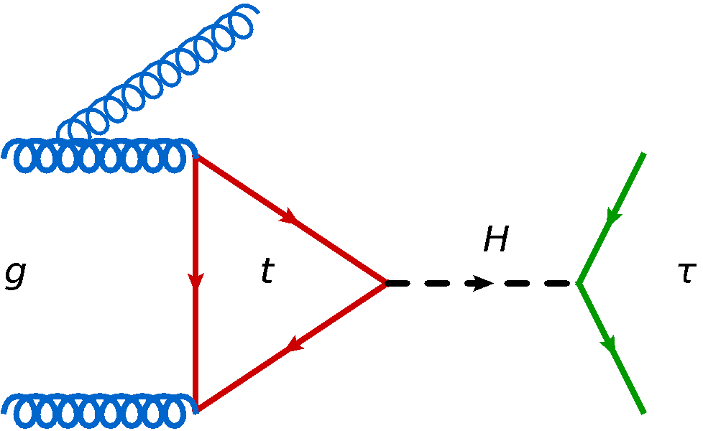
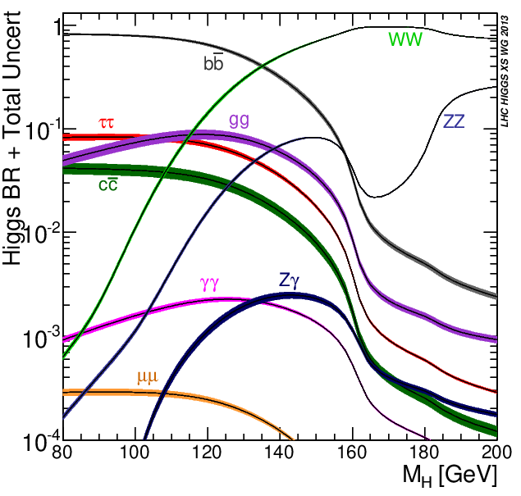
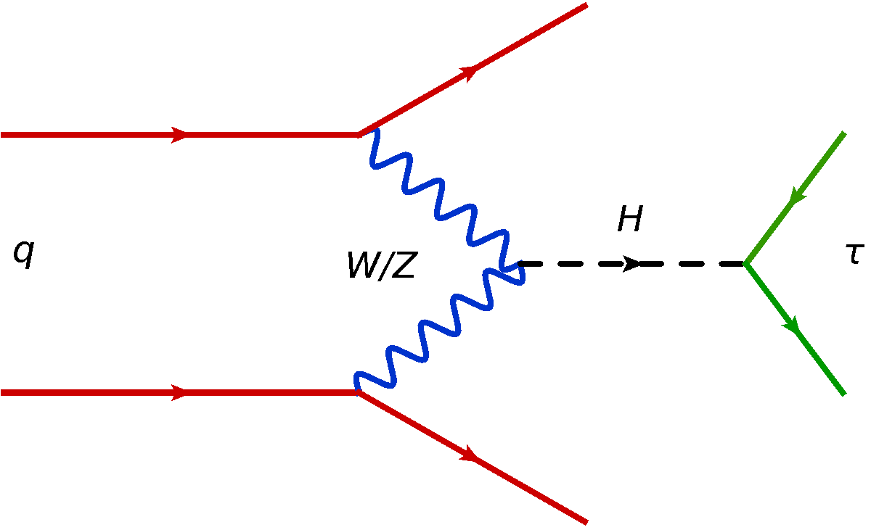
gluon-gluon fusion
σ ≈ 44 pb @ √s = 13 TeV
vector-boson fusion
σ ≈ 4 pb @ √s = 13 TeV

Slide 9
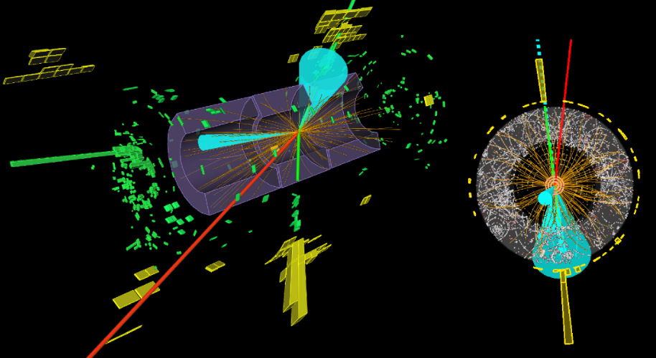
large m_{jj}, Δη
jet
jet
1-track
hadronic τ
μ
m_{H} ≈ 129 GeV
centrally produced

Slide 10
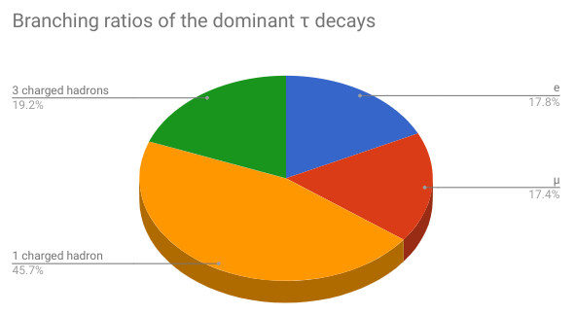
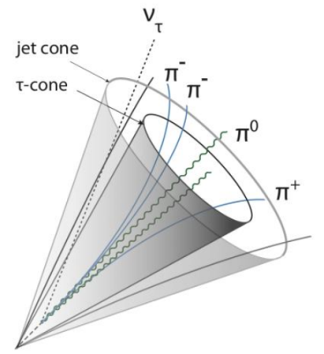
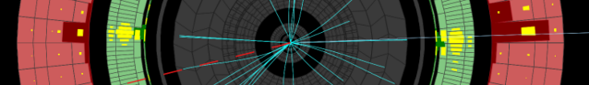
✓
hmm…
✓
3-track τ_{h}
1-track τ_{h}

Slide 11
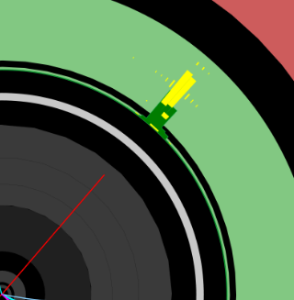
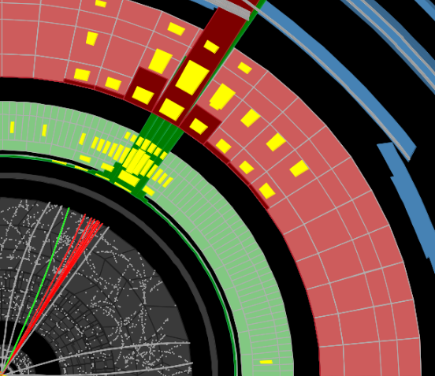
electron
QCD jet

Slide 12
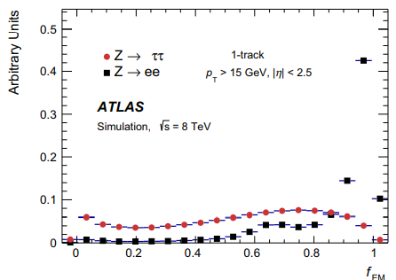
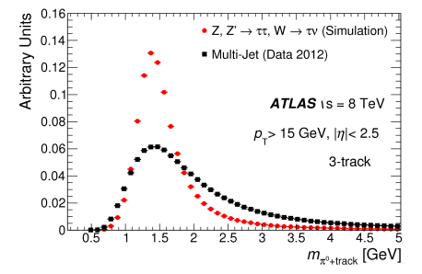
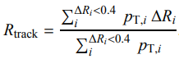
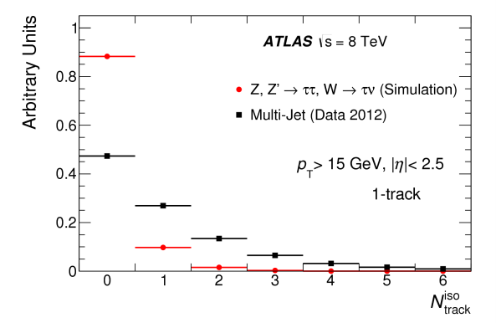
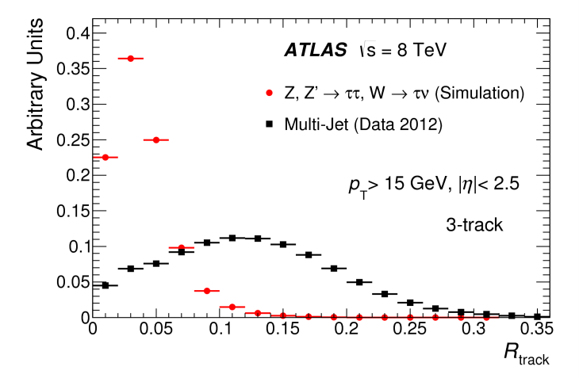
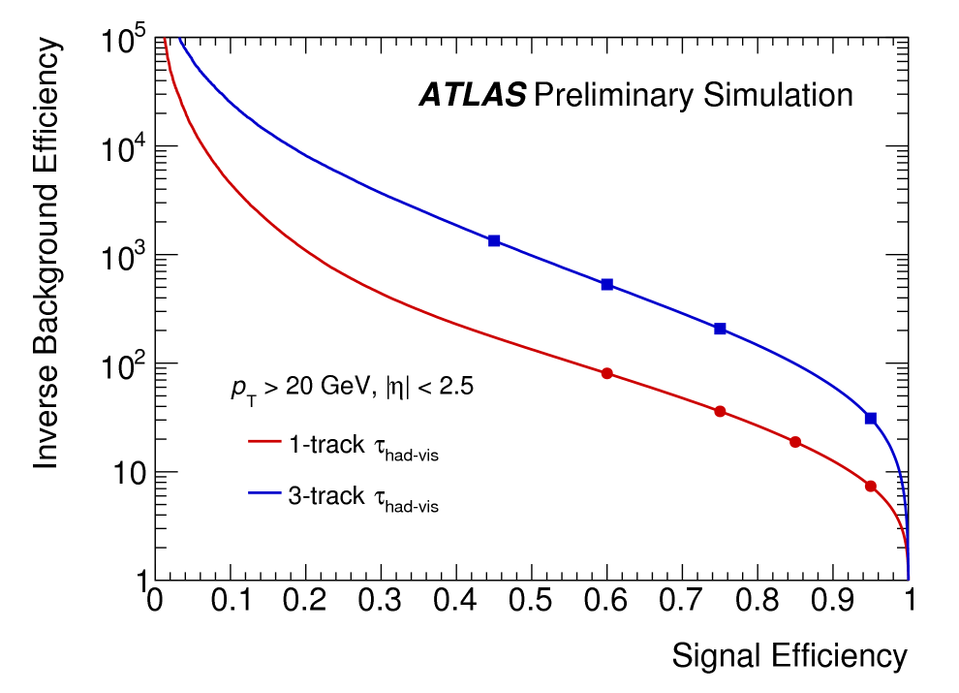
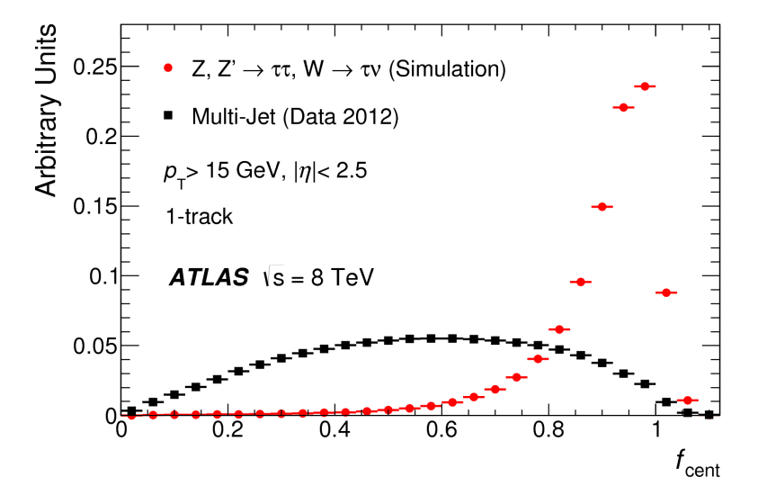
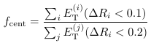
Machine
Learning

Slide 13
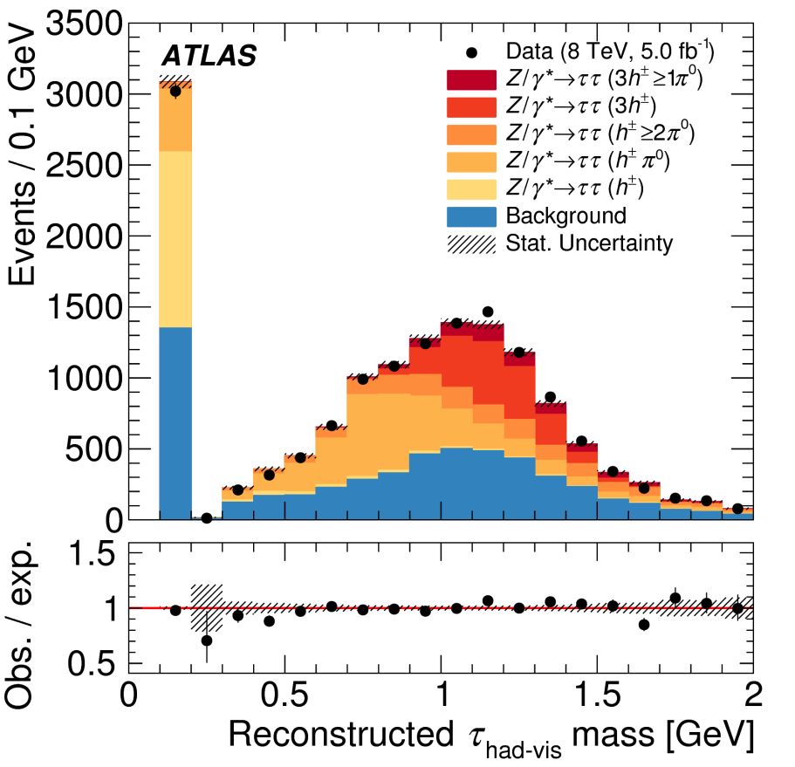
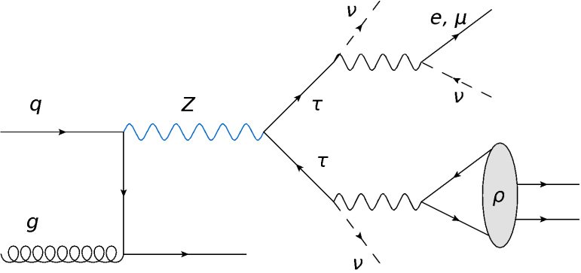
τ⁻ → ν_{τ} π⁻ π⁰
ρ(770)

Slide 14
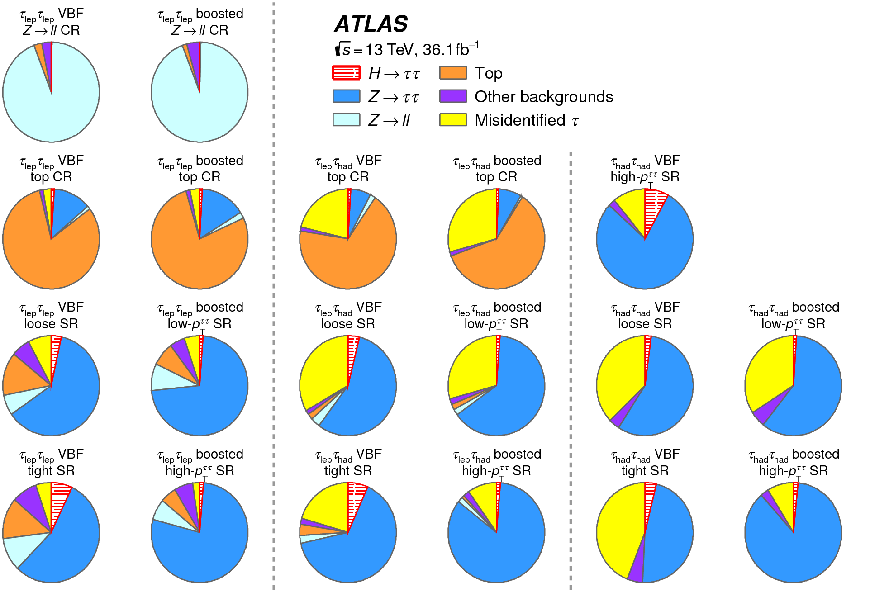
control
regions

τ_{lep}τ_{lep}
τ_{lep}τ_{had}
τ_{had}τ_{had}
signal
regions



Slide 15
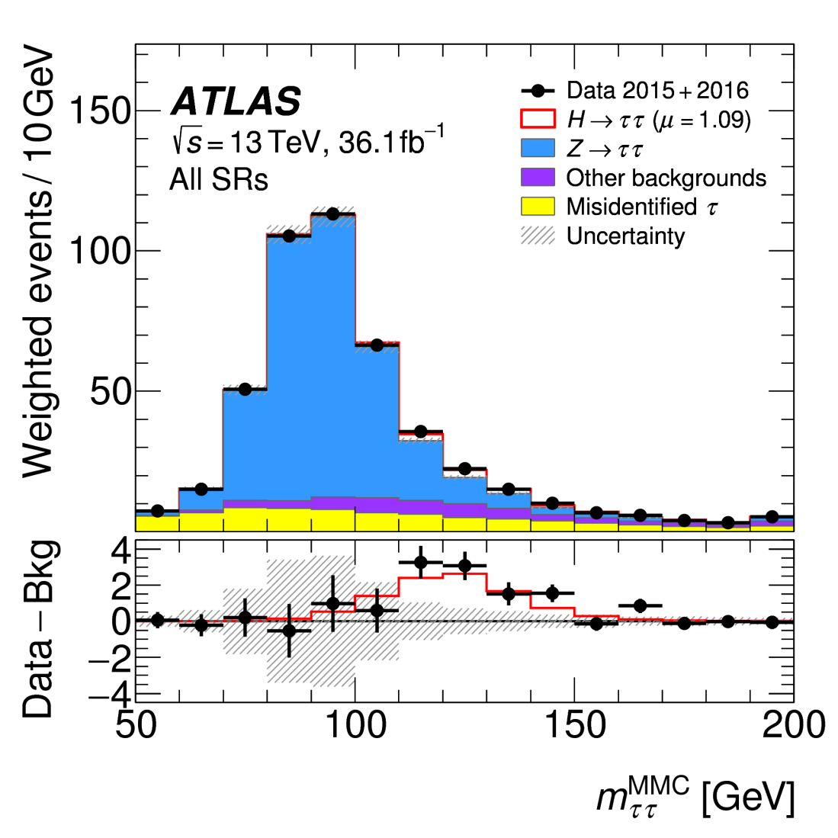
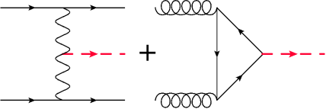

Slide 16
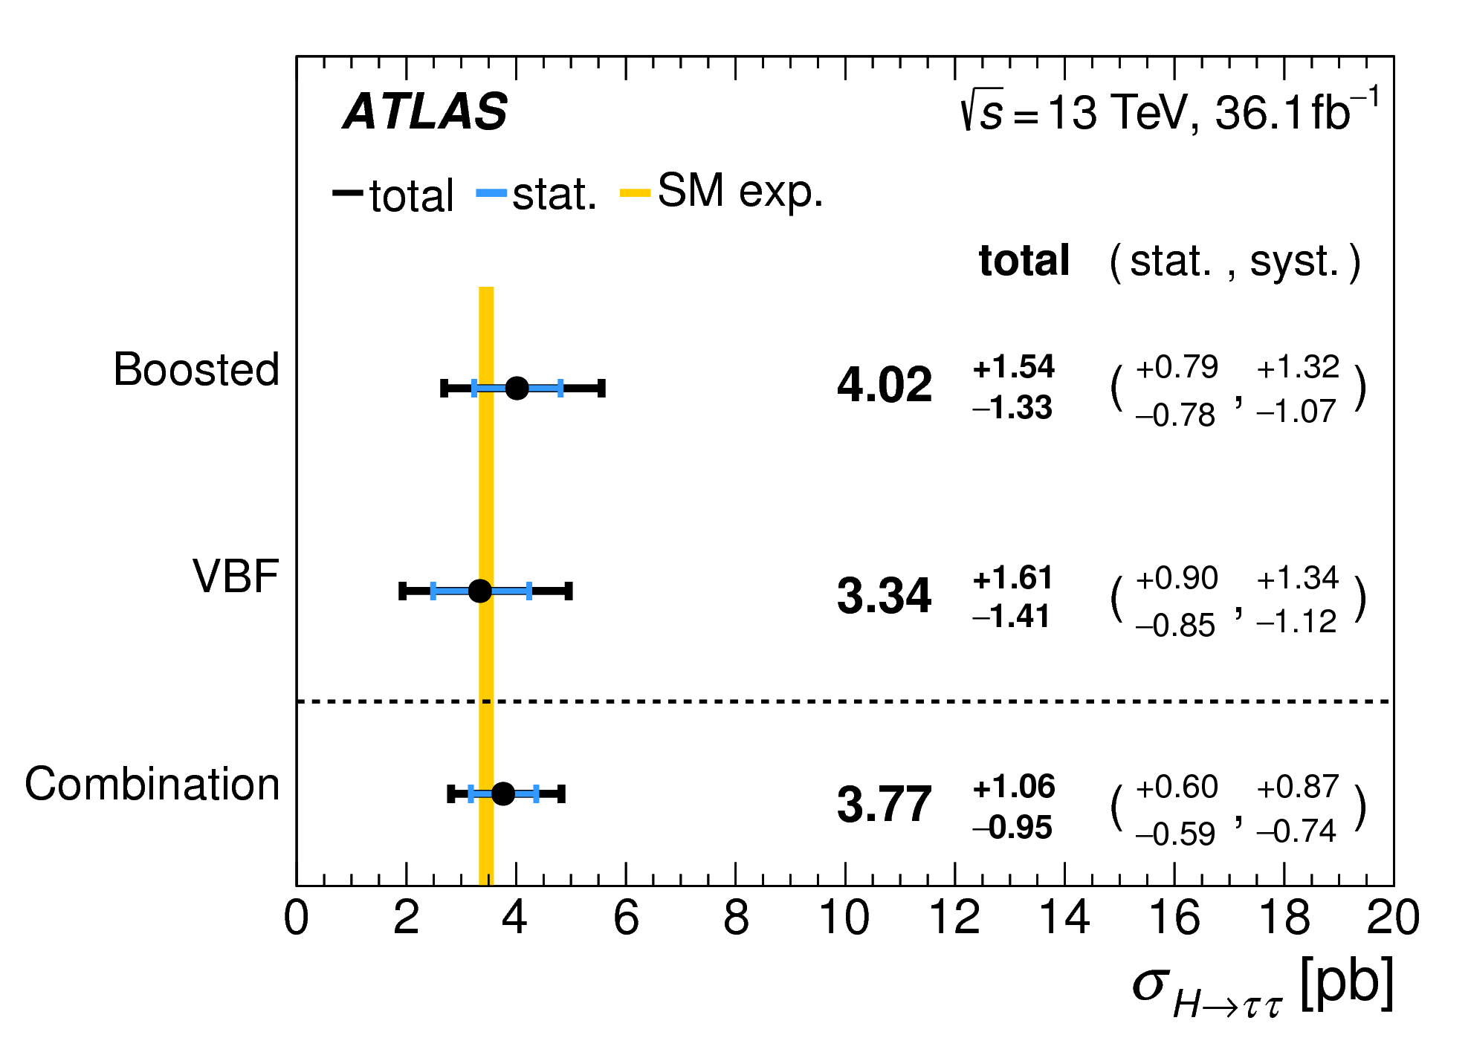

Slide 17
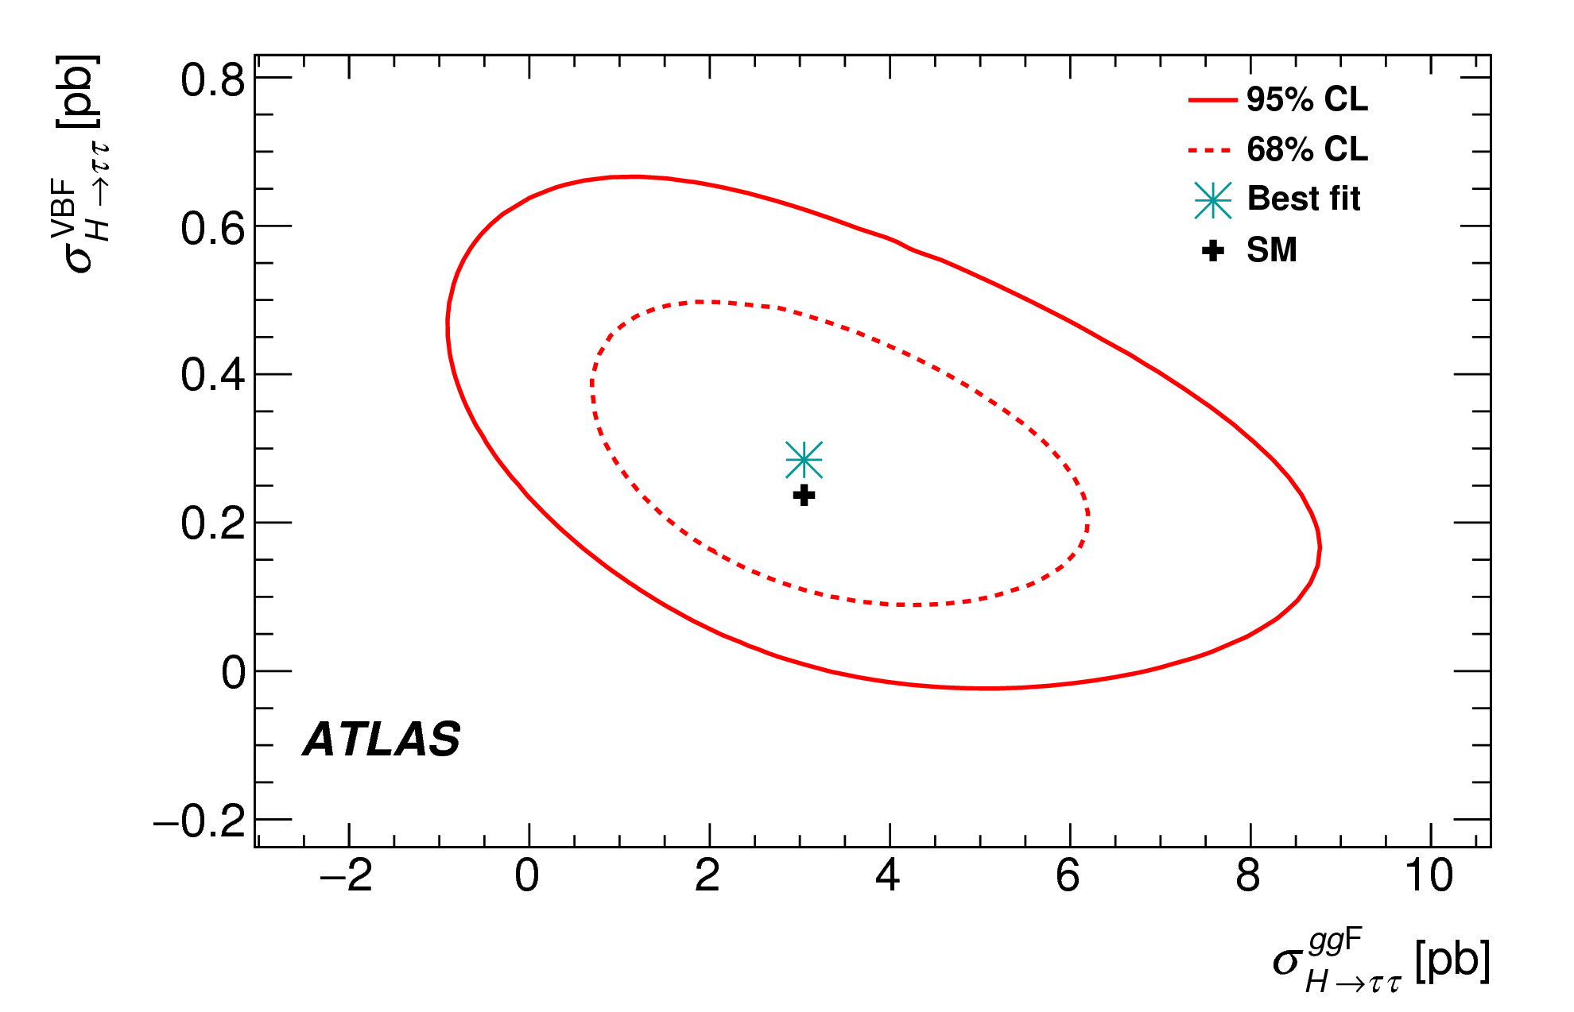

Slide 18
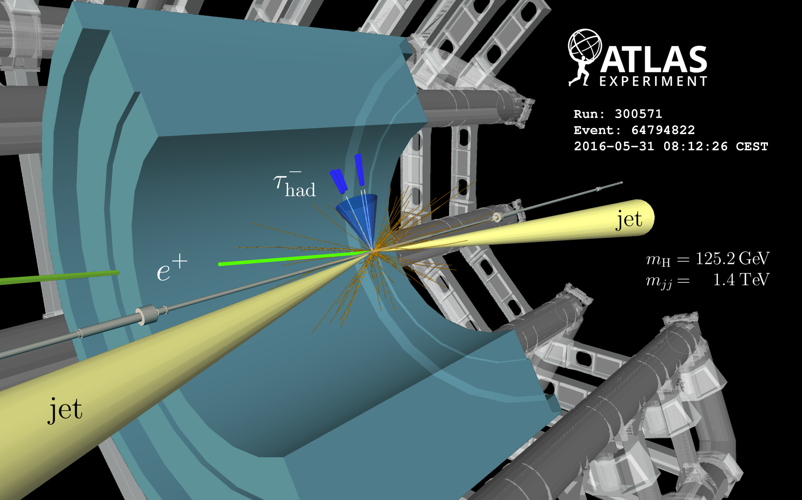
VBF Higgs event
√s = 13 TeV

Slide 19
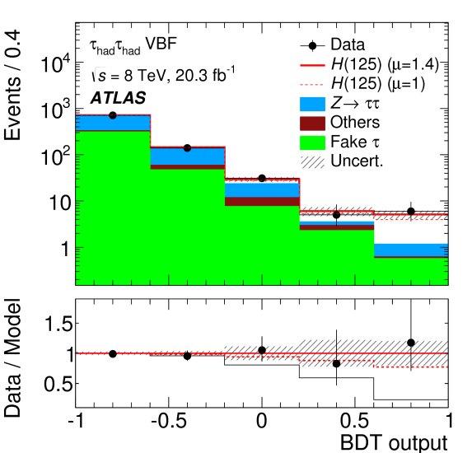
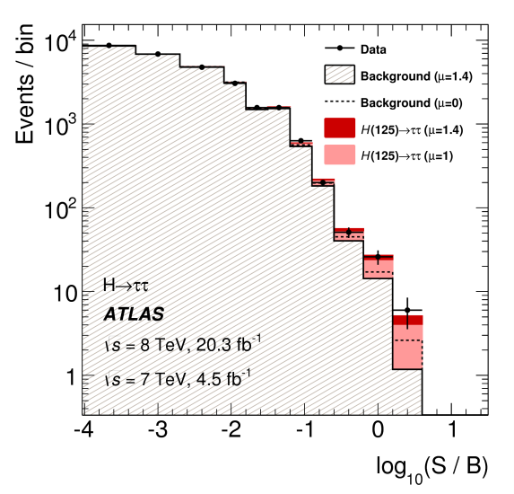
√s = 7, 8 TeV
⊕
√s = 13 TeV
√s (TeV) | 7, 8 | 13 | Combined
Observed (σ) | 4.5 | 4.4 | 6.4
Expected (σ) | 3.4 | 4.1 | 5.4

Slide 20
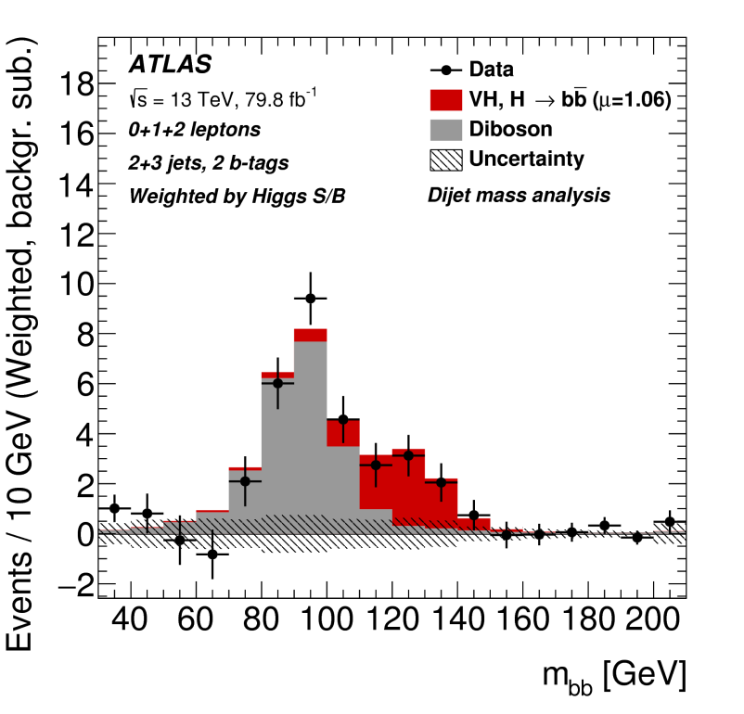
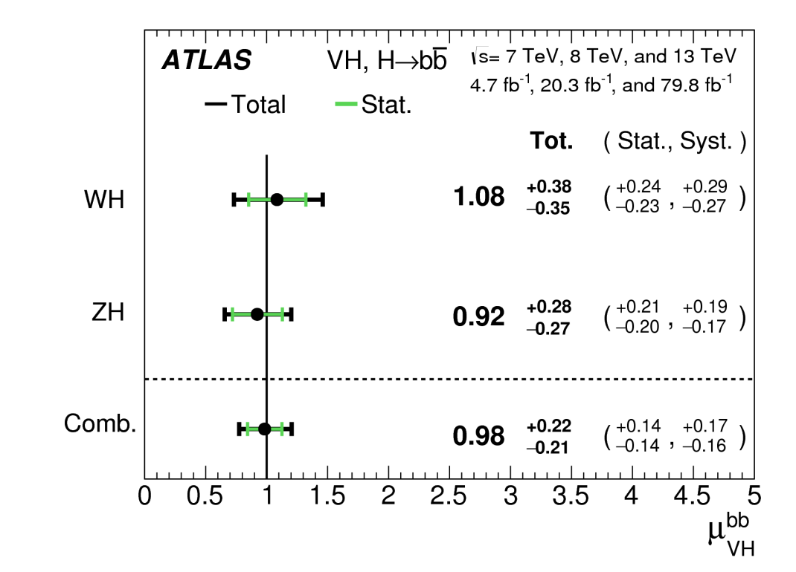
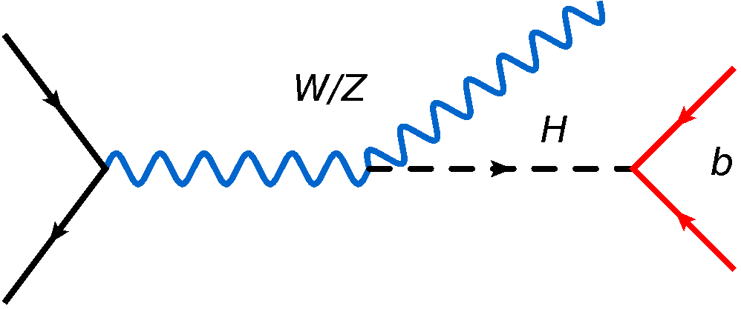
S_{obs} = 5.3σ
S_{exp} = 4.8σ
weak boson associated production
σ ≈ 2 pb @ √s = 13 TeV

Slide 21
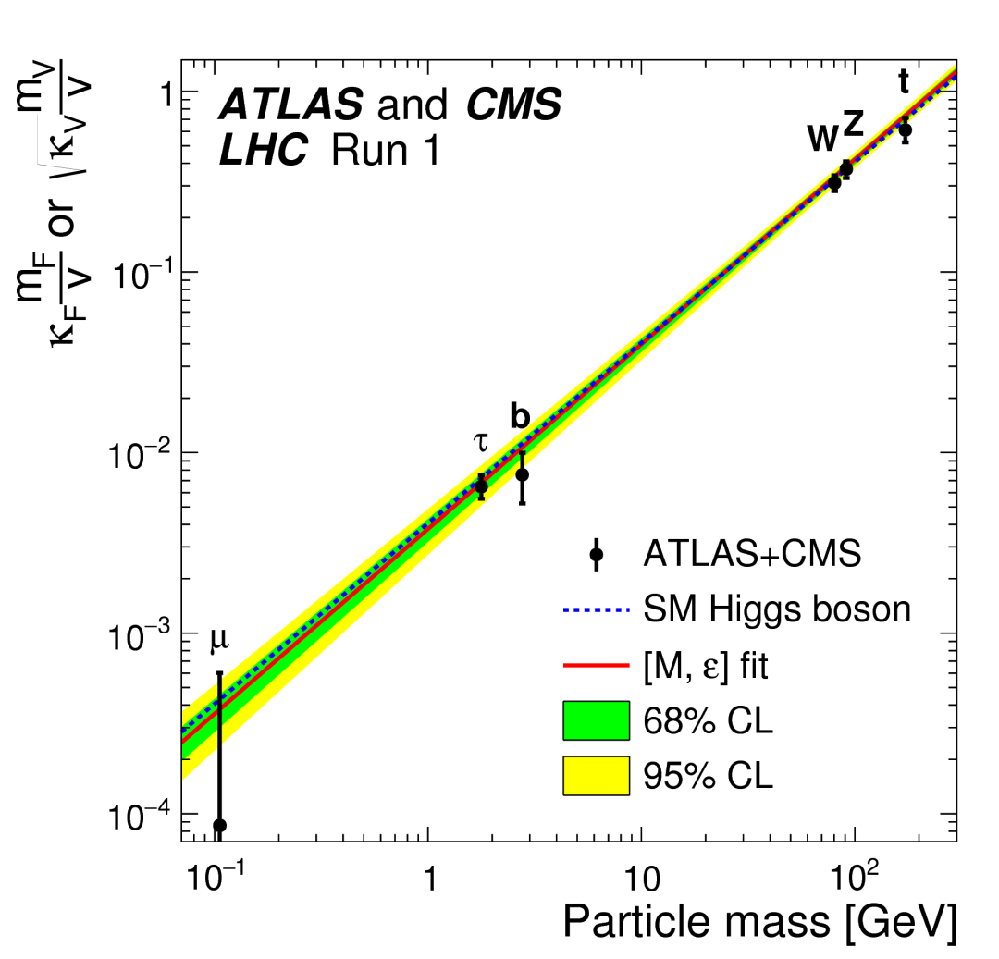
coupling modifier

Slide 22
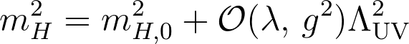
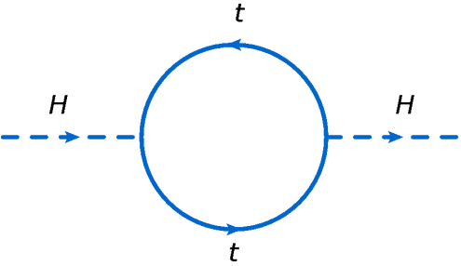
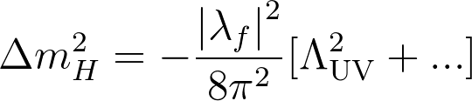
=
+ …
divergent

Slide 23
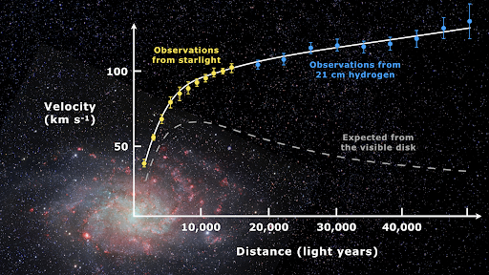
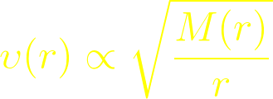
stable Keplerian orbit

Slide 24
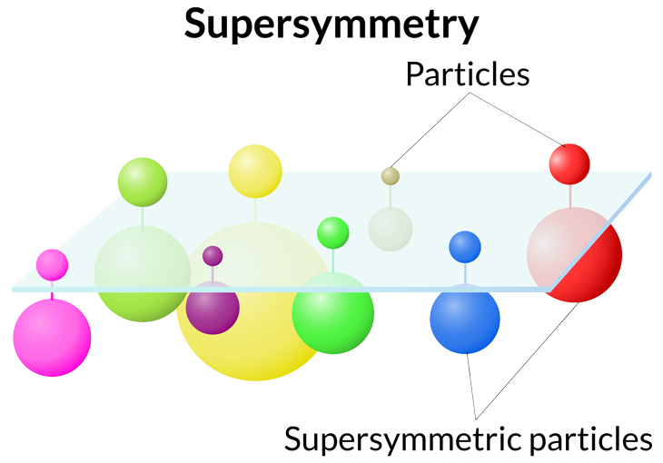
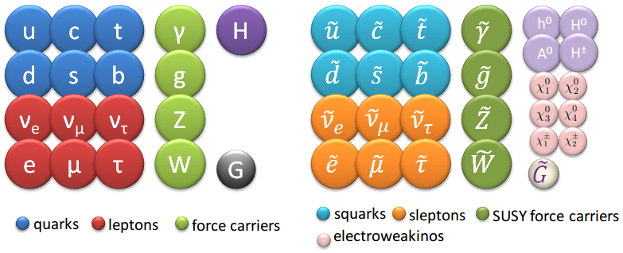

Slide 25


=
+ …
natural cancellation

Slide 26

SM
MSSM
GUT

Slide 27

+1 (SM)
-1 (MSSM)
R = (-1)^{3(B-L)+2s}
= WIMP?

Slide 28

colored
sector
ewk
sector

Slide 29

strong
SUSY
ewk
SUSY

Slide 30






Z*
μ
W*
soft p_{T} leptons
higgsino triplet
Z/h
hard p_{T} leptons
General Gauge-Mediated supersymmetry breaking

Slide 31


Slide 32



h
Z

Slide 33





⟨μ⟩ ≈ 30
LHC
HL-LHC
⟨μ⟩ ≈ 200

Slide 34



κ_{t}
κ_{λ}
+
TGC
-
-
QGC
9k HH→bbττ events
@ 3ab⁻¹,√s = 14 TeV

Slide 35



Slide 36




HL-LHC
LEP exclusion
m($\tilde{τ}$) ≳ 90 GeV

Slide 37

Synopsis
Culmination of work and plethora of exciting physics searches at LHC.
With the HL-LHC and other future collider projects, the exploration of physics at the Terascale is more plausible than ever!
Copious data at unprecedented center-of-mass energies are expected to unveil hidden sectors of the “Fabric of the Cosmos”.
The future of High Energy Physics is bright!

